Slide 1
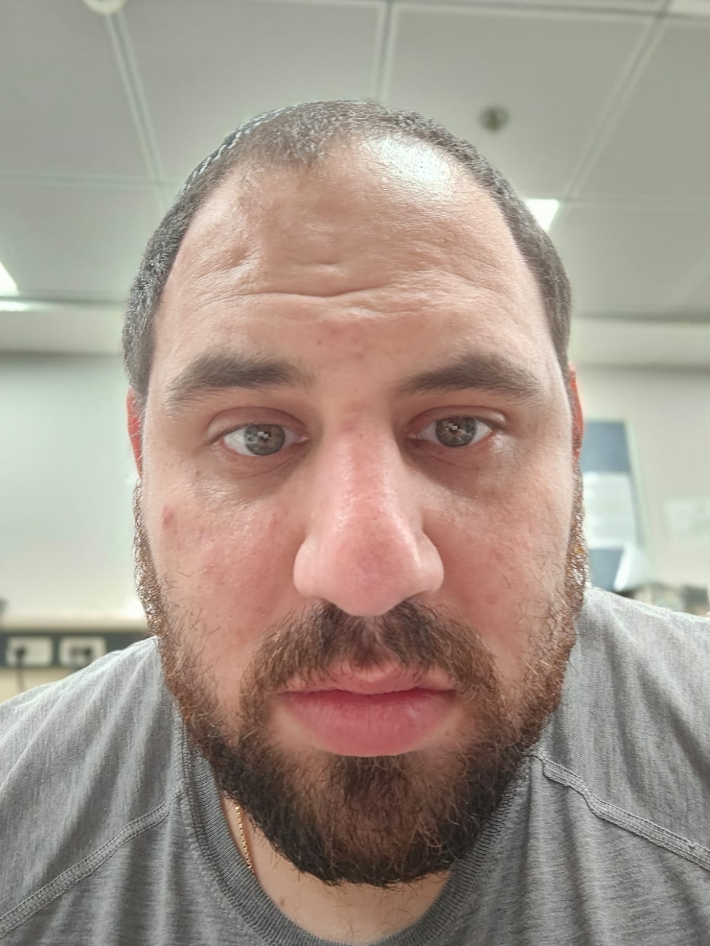


Course: Image Processing 31651 Assignment #11 Synthetic Image Creation (Part 1) – version 3
1
Photo of the student | Shorten Name | ID (4 last digits)
 | shienfeld | 1950 | Student #1
 | pony | 2210 | Student #2
 | akimov | 7939 | Student #3

Slide 2
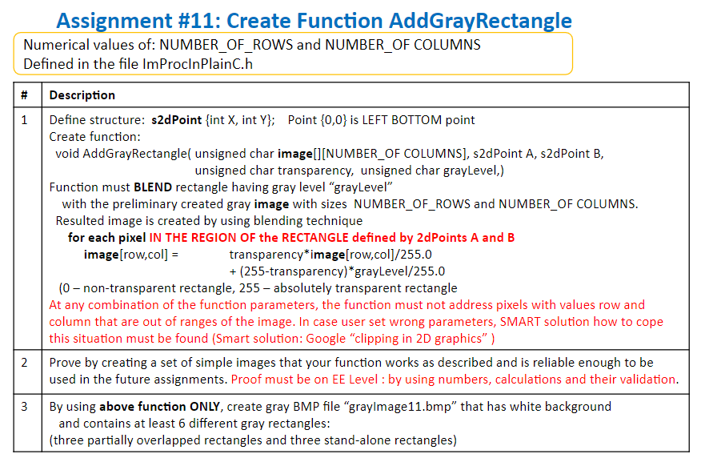
2

Slide 3
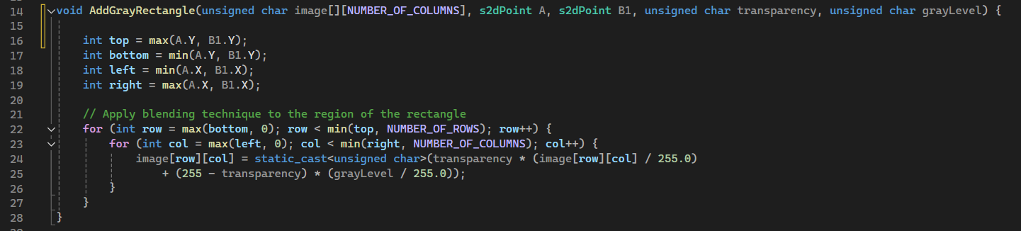
11.1 - Code of the function “AddGrayRectangle” – part 1
3
image[row,col] = transparency*image[row,col]/255.0 + (255-transparency)*grayLevel/255.0
Although the task did not demand presenting the s2dpoint struct – we decided to present it in part 2 of 11.1 – see next slide.

Slide 4
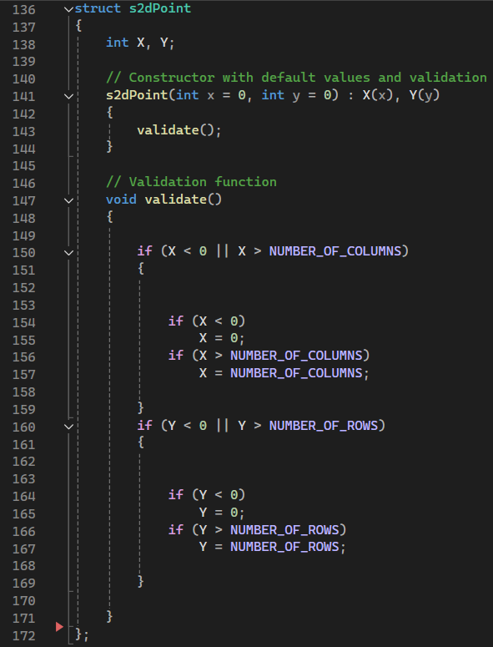
11.1 - Code of the function “AddGrayRectangle” – part 2
4
Here is the presentation of the s2dpoint struct – it includes the mechanism for prevent any clipping problem. The use of it will be demonstrated in the next slides.
Another important notation : we added the s2dpoint to the header file as an object-oriented approach.

Slide 5
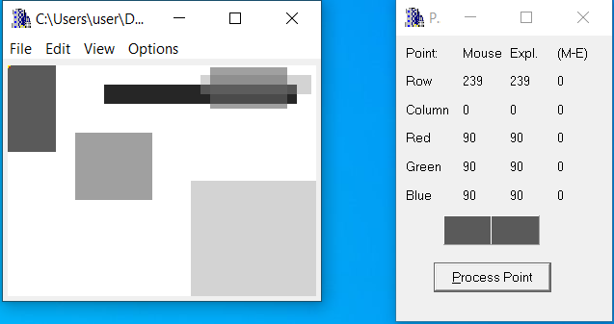
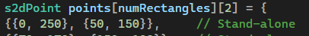
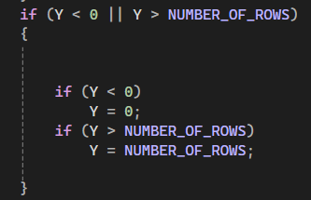
11.2 - List of situations tested – part 1
5
The point we test
In order to test clipping from the top (row direction) -we changed the value of the first rectangle from 239 to 250 – increase by 11 – to test the clipping. We expect the rectangle will be drawn and the point will be the at B1 max value which is 239!
The code for preventing clipping in the y direction (located at the header file)
As expected!

Slide 6
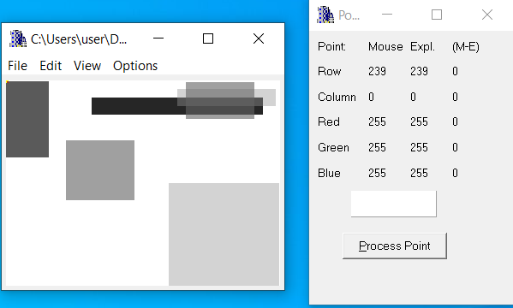
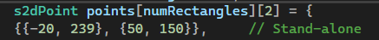
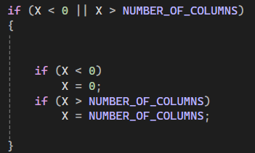
11.2 - List of situations tested – part 2
6
The point we test
In order to test clipping from the left (column direction) - we changed the value of the first rectangle from 0 to -20 – decreasing by 20 – to test the clipping. We expect the rectangle will be drawn and the point will be the at A min value which is 0!
The code for preventing clipping in the x direction (located at the header file)
As expected!

Slide 7
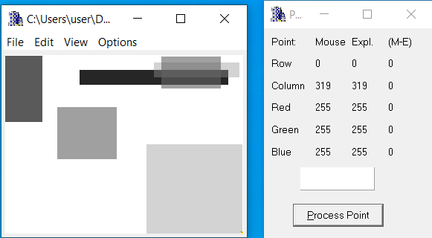
11.2 - List of situations tested – part 3
7
In order to test clipping from the bottom (row direction) - we changed the value of the third rectangle from 0 to -10 – decreasing by 10 – to test the clipping. We expect the rectangle will be drawn and the point will be the at B1 min value which is 0!
The code for preventing clipping in the x direction (located at the header file)
The point we test
As expected!

Slide 8
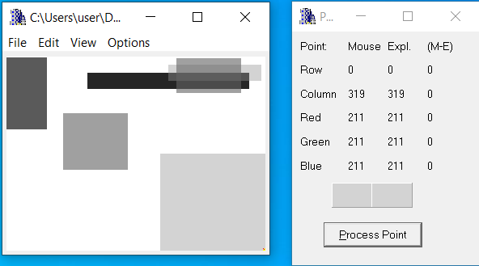
11.2 - List of situations tested – part 4
8
In order to test clipping from the right (column direction) - we changed the value of the third rectangle from 319 to 340 – decreasing by 21 – to test the clipping. We expect the rectangle will be drawn and the point will be the at A min value which is 319!
The code for preventing clipping in the y direction (located at the header file)
The point we test
As expected!

Slide 9
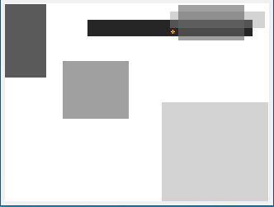
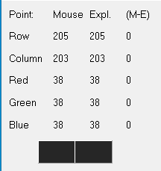
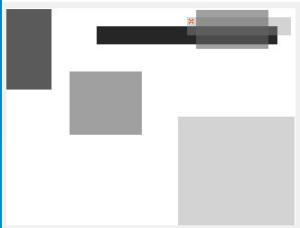
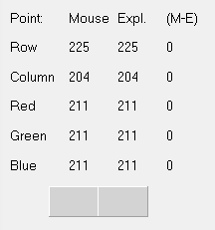
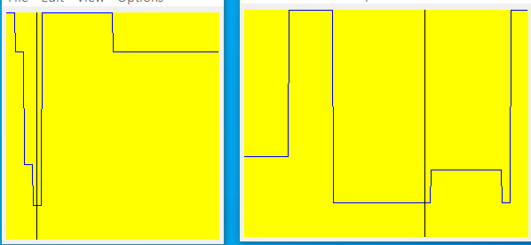
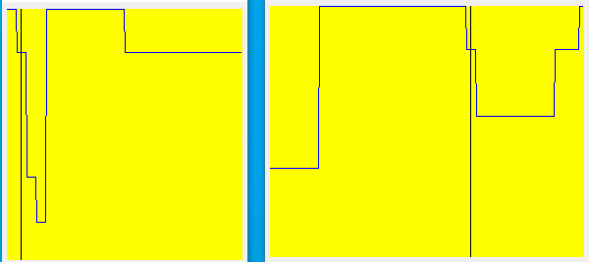
11.3 - For the specific test images (see 11.2) - relevant profiles and refer relevant lines of code to prove that specific test having specific rectangle were created as required – part 1
9
b
a

Slide 10

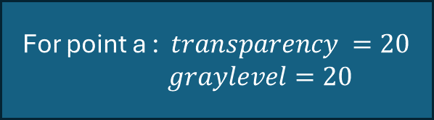
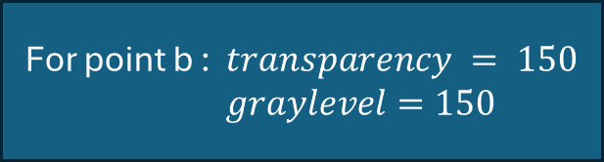
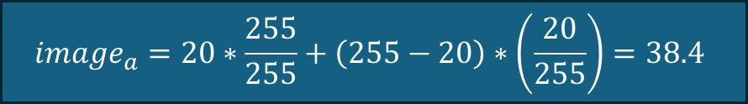

11.3 - For the specific test images (see 11.2) - relevant profiles and refer relevant lines of code to prove that specific test having specific rectangle were created as required – part 2
10
image[row,col] = transparency*image[row,col]/255.0 + (255-transparency)*grayLevel/255.0
For point b : $transparency = 150$
$graylevel=150$
For point a : $transparency =20$
$graylevel=20$
$$image_{b}=150∗\frac{255}{255}+\left(255−150\right)∗\left(\frac{150}{255}\right)=211.7$$
$$image_{a}=20∗\frac{255}{255}+\left(255−20\right)∗\left(\frac{20}{255}\right)=38.4$$
Real results
Real results

Slide 11
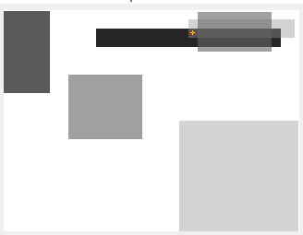
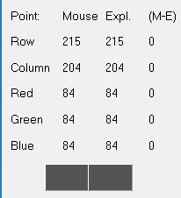
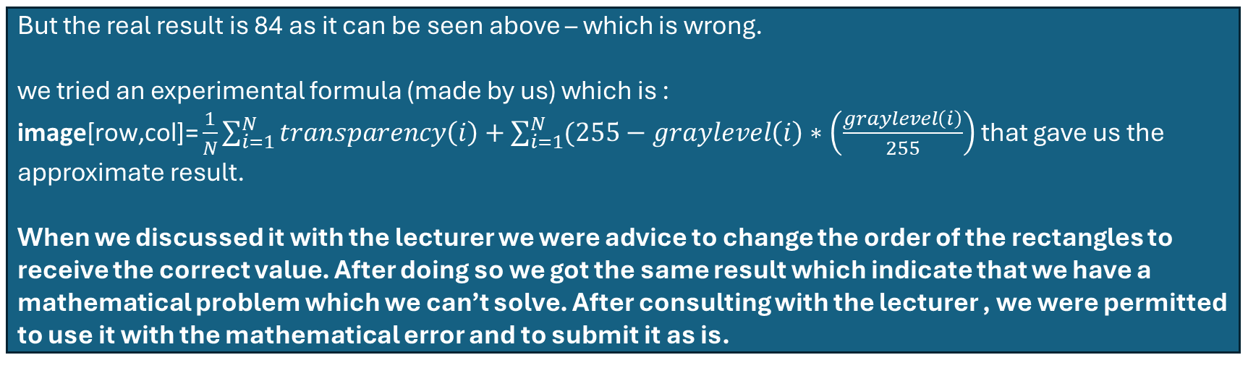
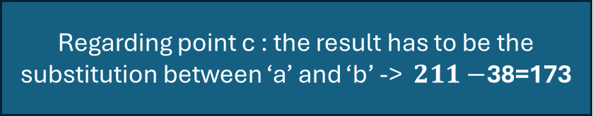
11.3 - For the specific test images (see 11.2) - relevant profiles and refer relevant lines of code to prove that specific test having specific rectangle were created as required – part 2
11
c
Regarding point c : the result has to be the substitution between ‘a’ and ‘b’ -> $211−$38=173
But the real result is 84 as it can be seen above – which is wrong.
we tried an experimental formula (made by us) which is : $\text{image}\text{[}\text{row}\text{,}\text{col}\text{]=}\frac{1}{N}\sum_{i=1}^{N}{transparency\left(i\right)+\sum_{i=1}^{N}{(255−graylevel\left(i\right)∗\left(\frac{graylevel\left(i\right)}{255}\right)} }$that gave us the approximate result.
When we discussed it with the lecturer we were advice to change the order of the rectangles to receive the correct value. After doing so we got the same result which indicate that we have a mathematical problem which we can’t solve. After consulting with the lecturer , we were permitted to use it with the mathematical error and to submit it as is.

Slide 12
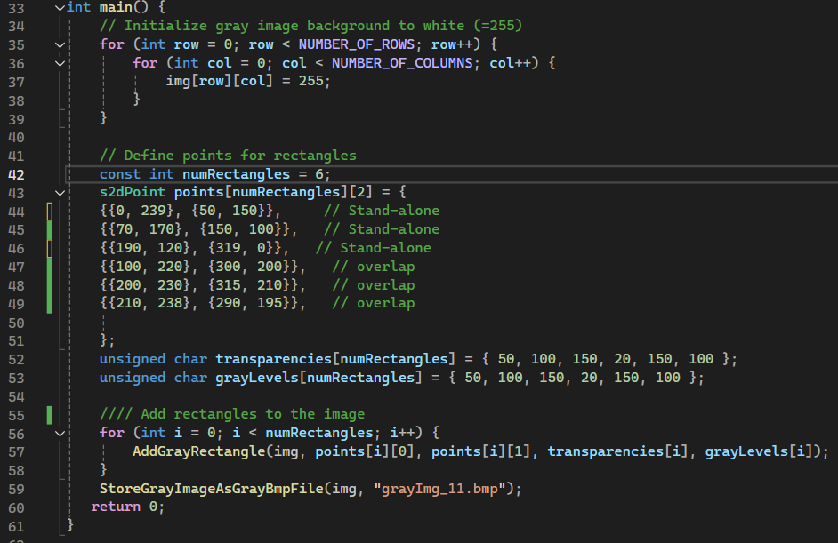
11.4 - Code of the “main” function and set of intermediate images - part 1
12
In addition – as mentioned before – the s2dpoint struct & the validation process to prevent clipping in located at the header file

Slide 13



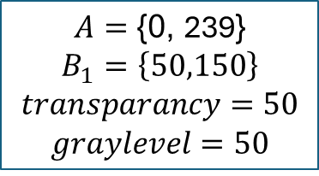
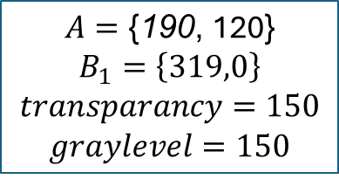

11.4 - Code of the “main” function and set of intermediate images - part 2
13
The set of the intermediate images – every new rectangle (6 total) will be numbered and its A and B1 coordinates & their transparencies and gray levels – will be written next to the new image
1
2
3
$$A=\text{\{}\text{0}\text{,} \text{239}\text{\}}$$
$$B_{1}=\left\{50,150\right\}$$
$$transparancy=50$$
$$graylevel=50$$
$$A=\text{\{}\text{7}\text{0}\text{,} \text{170}\text{\}}$$
$$B_{1}=\left\{150,100\right\}$$
$$transparancy=100$$
$$graylevel=100$$
$$A=\text{\{}\text{190}\text{,} \text{120}\text{\}}$$
$$B_{1}=\left\{319,0\right\}$$
$$transparancy=150$$
$$graylevel=150$$
Continue in the next slide

Slide 14


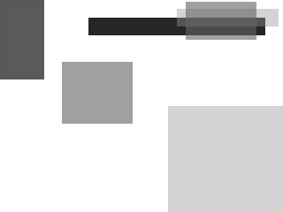
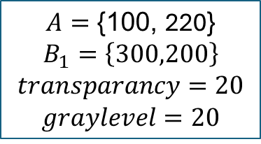
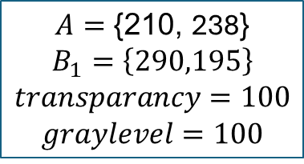

11.4 - Code of the “main” function and set of intermediate images - part 3
14
The set of the intermediate images – every new rectangle (6 total) will be numbered and its A and B1 coordinates & their transparencies and gray levels – will be written next to the new image
5
4
$$A=\text{\{}\text{10}\text{0}\text{,} \text{220}\text{\}}$$
$$B_{1}=\left\{300,200\right\}$$
$$transparancy=20$$
$$graylevel=20$$
$$A=\text{\{}\text{20}\text{0}\text{,} \text{230}\text{\}}$$
$$B_{1}=\left\{315,210\right\}$$
$$transparancy=150$$
$$graylevel=150$$
6
$$A=\text{\{}\text{21}\text{0}\text{,} \text{238}\text{\}}$$
$$B_{1}=\left\{290,195\right\}$$
$$transparancy=100$$
$$graylevel=100$$

Slide 15
11.4 - Code of the “main” function and set of intermediate images - part 4
15
The final form – all 6 rectangles – is:

Slide 16
11.5 – what did we learned?
16
We learned how to use the bmp viewer
How overlapping creates different shades from the original and how its calculated
How to avoid clipping using smart solutions
We learned to create a grayscale image in the location and size we
wanted, and changed the values of graylevel and transparency to see how it affects the grayscale.

